Slide 1


Slide 2
Architecture of Neural Networks
It is composed of set of nodes connected by directed links.
Nodes perform the static node function.
Link specifies the direction of signal flow.
Node function is a parameterized function with modifiable parameters.

Slide 3
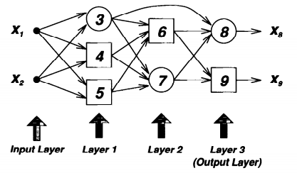
Neural network with two inputs and two outputs

Slide 4
Parameters of neural networks are distributed into its nodes.
Each node has a local parameter set.
Node function depends on parameter values if nodes parameter set is not empty.
It is represented by a square.
Node function is fixed if parameter set is empty and represented by a circle.

Slide 5
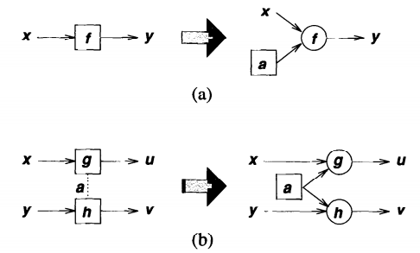
Decomposition of nodes
Fig (a): y=f(x,a) ; where a is parameter of node
Fig(b):u=g(x,a)& v=h(y,a); where a is the common parameter

Slide 6
Topologies of Neural Network
The pattern of connections between the units and the propagation of data.
Types of topologies:
1. Feed-forward neural networks
2. Recurrent neural networks

Slide 7
Feed-forward neural networks
Output of each node propagates from the input side to the output side.
No feedback connection.
It is represented by an acyclic directed graph.
It can be represented in two ways:
(i) Layered representation
(ii) Topological representation

Slide 8
Layered representation:
In this there are no links between nodes in the same layer.
Outputs of the nodes in a specific layer are connected to the node in the succeeding layers.
It is preferred because of its modularity i.e. nodes in the same layer has same functionality.
It generates same level of abstraction.

Slide 9
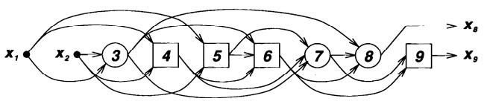
Topological representation:
It labels the nodes in a ordered sequence.
There are no links from node i to j, when i≥j.
It is less modular than layered representation.
It facilitates the formulation of learning rules.
It is considered as a special case of layered representation, with one node per layer.

Slide 10
Mapping of Feed-forward network:
It is a static mapping between input and output spaces.
Mapping can be simple linear relation or highly non-linear, depending on the network structure and functionality of nodes.
Mapping is regulated by a data set, containing desired input- output payers of the system to be modeled.
This data set is called learning data set.
The procedure for adjusting the parameter is called learning rule or adaption algorithm.

Slide 11
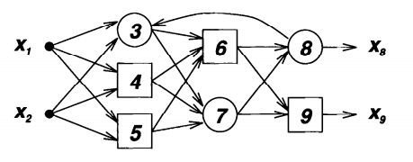
Recurrent Neural Network
If there is a feedback link in a feed-forward representation, then it becomes recurrent.
It forms a circular path in the network.
It always contains at least one directed cycle.

Slide 12
It use their internal memory to process arbitrary sequences of inputs.
It exhibits dynamic temporal behavior.
It is used in handwriting recognition system.
The recurrence makes the networks to process sequentially.

Slide 13
Architecture of Recurrent Networks:
(i) Fully recurrent network:
  It is a basic architecture, developed in 1980’s .
  In this each unit has a time varying real valued activation.
(ii) Hopfield network:
  It is a recurrent network in which all connection are symmetric.
  It is a network in which nodes are connected to each other but no node has any connection to itself.
  It is tool for solving optimization problem.

Slide 14
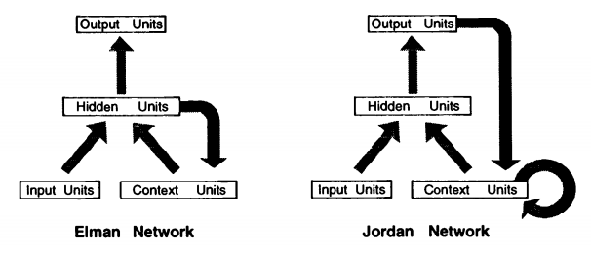
(iii) Elman & Jordan network:
  It is a three layer network with a set of context units in the input layer.
  There is a connection between context unit and hidden layer with a weight of one.

Slide 15
(iv) Bi-directional recurrent neural network:
  Based on the past and the future context of the element, the finite sequence is predicted and labeled.
  It is done by adding two RNN in which one processes the sequence from left to right and other vice-versa.
(v) Long short term memory network:
  It works even when there are long delay.
  It can handle signals that have both low and high frequency components.

Slide 16
(vi) Hierarchical recurrent neural network:
  In this elements are connected in various ways to decompose hierarchical behavior into useful subprogram.

Slide 17


